Slide 1
dZAP1 STEM Profiles

Slide 2
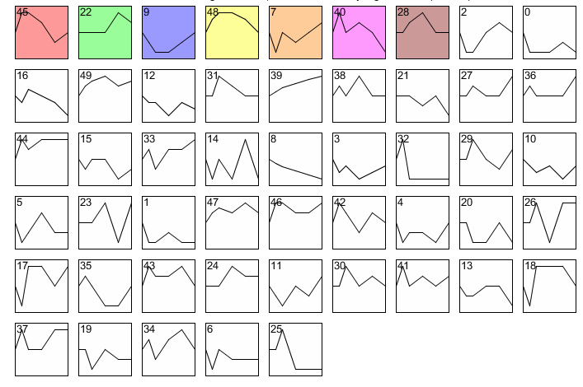
dZAP1 all STEM profiles

Slide 3
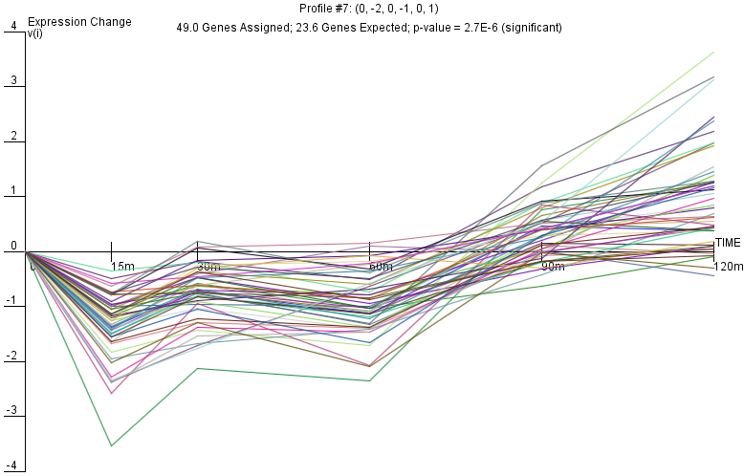
dZAP1 Profile 7

Slide 4
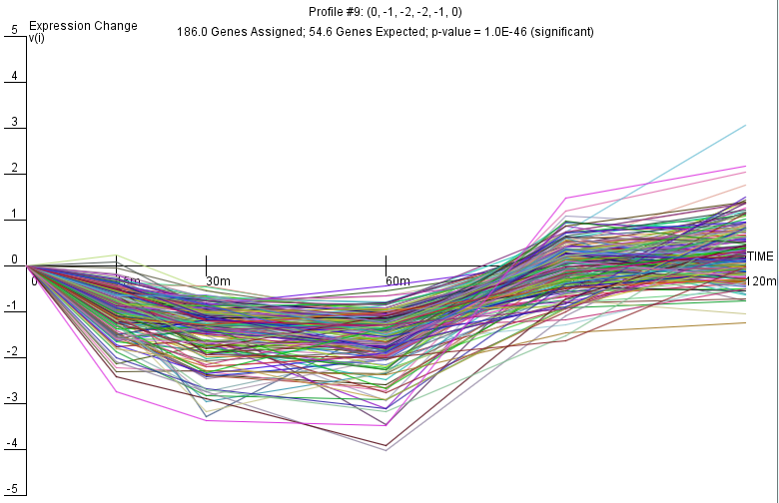
dZAP1 Profile 9

Slide 5
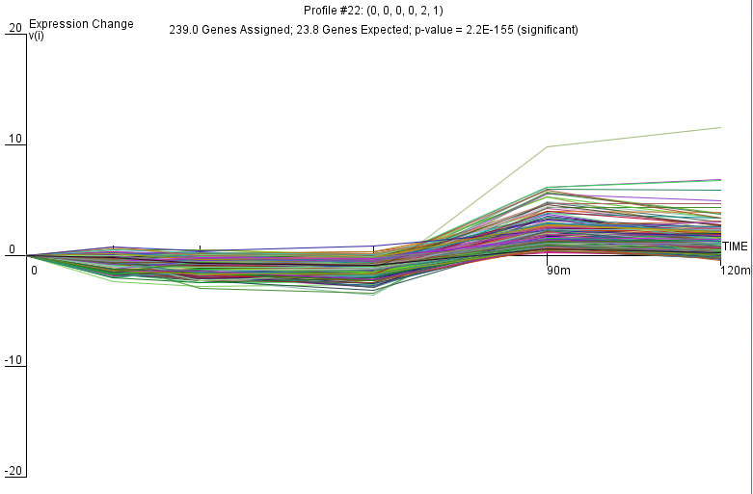
dZAP1 Profile 22

Slide 6
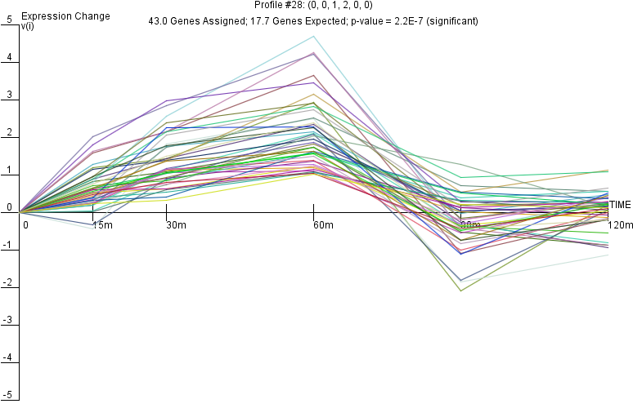
dZAP1 Profile 28

Slide 7
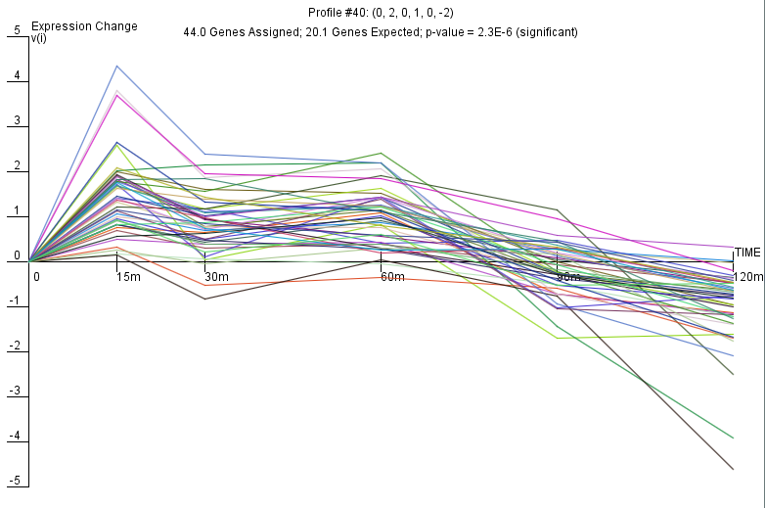
dZAP1 Profile 40

Slide 8
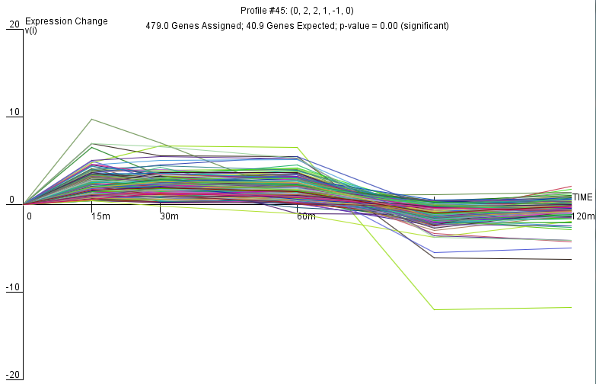
dZAP1 Profile 45

Slide 9
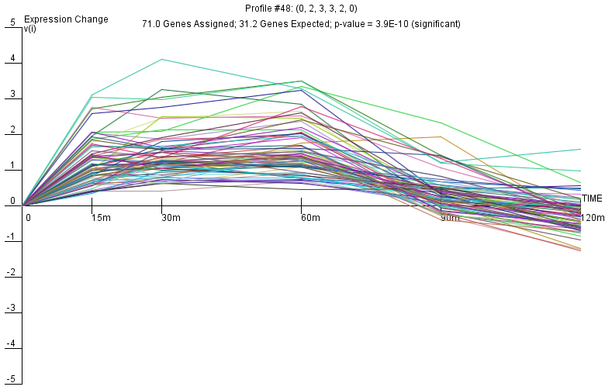
dZAP1 Profile 48

